Slide 1



Workshop 2018
C# Scripting and Plugin Development
for Grasshopper
A Gentle Introduction to Hardcore Programming for Computational Design
LONG NGUYEN
Research Associate
Institute for Computational Design (ICD)
University of Stuttgart
26,27,28 / 04 / 2018

Slide 2
Visual Studio
Grasshopper API
Develop Grasshopper plugins
Objected-Oriented Programming
Meshes
Major Exercise: Mesh-growth by adaptive subdivsion
Day 2
27/04/2018

Slide 3
Visual Studio
An IDE (Integrated Development Environment)
A special kind of software program (and accompanying toolset) that help us develop (other) software products
Very powerful and popular
Supports C++, C#, Visual Basic
Officially supports Python since version 2015
We will use VS to develop plugins for Grasshopper using C#

Slide 4


Live Example: Our first Grasshopper plugin

Slide 5
C# class definition “template” for a custom Grasshopper component
using ...
namespace Workshop
{
public class MyFirstGrasshopperComponent : GH_Component
{
public MyFirstGrasshopperComponent()
: base("MyComponent", "Nickname", "Description", "Category", "Subcategory")
{ }
protected override void RegisterInputParams(GH_Component.GH_InputParamManager pManager)
{ }
protected override void RegisterOutputParams(GH_Component.GH_OutputParamManager pManager)
{ }
protected override void SolveInstance(IGH_DataAccess DA)
{ }
protected override System.Drawing.Bitmap Icon { }
public override Guid ComponentGuid { }
}
}

Slide 6
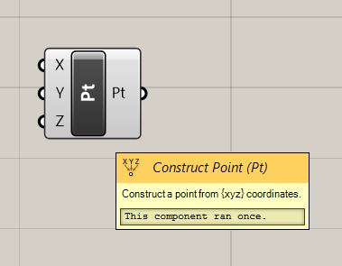
The constructor - example
using ...
namespace Workshop
{
public class MyFirstGrasshopperComponent : GH_Component
{
public MyFirstGrasshopperComponent()
: base("Component",
"Nickname",
"Description",
"Category",
"Subcategory")
{ }
...
}
}

Slide 7
The constructor - example
using ...
namespace Workshop
{
public class MyFirstGrasshopperComponent : GH_Component
{
public MyFirstGrasshopperComponent()
: base("Construct Point",
"Nickname",
"Description",
"Category",
"Subcategory")
{ }
...
}
}

Slide 8
The constructor - example
using ...
namespace Workshop
{
public class MyFirstGrasshopperComponent : GH_Component
{
public MyFirstGrasshopperComponent()
: base("Construct Point",
"Pt",
"Description",
"Category",
"Subcategory")
{ }
...
}
}

Slide 9
The constructor - example
using ...
namespace Workshop
{
public class MyFirstGrasshopperComponent : GH_Component
{
public MyFirstGrasshopperComponent()
: base("Construct Point",
"Pt",
"Construct a point from (xzy) coordinates",
"Category",
"Subcategory")
{ }
...
}
}

Slide 10
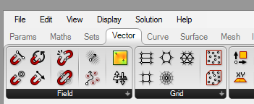
The constructor - example
using ...
namespace Workshop
{
public class MyFirstGrasshopperComponent : GH_Component
{
public MyFirstGrasshopperComponent()
: base("Construct Point",
"Pt",
"Construct a point from (xzy) coordinates",
"Category",
"Subcategory")
{ }
...
}
}

Slide 11
The constructor - example
using ...
namespace Workshop
{
public class MyFirstGrasshopperComponent : GH_Component
{
public MyFirstGrasshopperComponent()
: base("Construct Point",
"Pt",
"Construct a point from (xzy) coordinates",
"Vector",
"Subcategory")
{ }
...
}
}

Slide 12
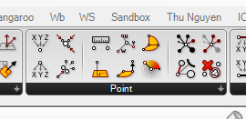
The constructor - example
using ...
namespace Workshop
{
public class MyFirstGrasshopperComponent : GH_Component
{
public MyFirstGrasshopperComponent()
: base("Construct Point",
"Pt",
"Construct a point from (xzy) coordinates",
"Vector",
"Subcategory")
{ }
...
}
}

Slide 13
The constructor - example
using ...
namespace Workshop
{
public class MyFirstGrasshopperComponent : GH_Component
{
public MyFirstGrasshopperComponent()
: base("Construct Point",
"Pt",
"Construct a point from (xzy) coordinates",
"Vector",
"Point")
{ }
...
}
}

Slide 14


Build and install

Slide 15
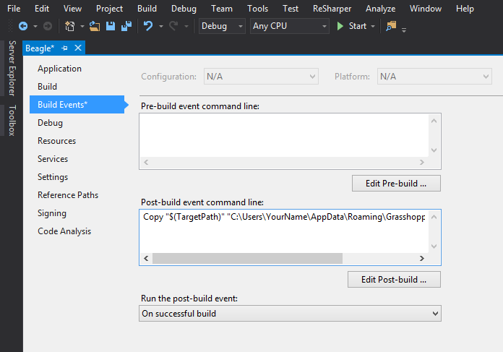
Automatically copy the built .gha file to the Grasshopper custom components folder
Copy "$(TargetPath)" "C:\Users\YourName\AppData\Roaming\Grasshopper\Libraries\Workshop.gha"

Slide 16

a + b
2
Live Example:
A component that computes
the average of two numbers

Slide 17
The “Average” component – The constructor
public class GhcAverage : GH_Component
{
public GhcAverage()
: base("Average of 2 numbers",
"Avrg",
"Compute the average of two numbers",
"Workshop",
"Utilities")
{ }
...
}

Slide 18
The “Average” component – Input and output parameters
public class GhcAverage : GH_Component
{
...
protected override void RegisterInputParams(GH_Component.GH_InputParamManager pManager)
{
pManager.AddNumberParameter("First Number", "First", "The first number", GH_ParamAccess.item, 0.0);
pManager.AddNumberParameter("Second Number", "Second", "The second number", GH_ParamAccess.item, 0.0);
}
protected override void RegisterOutputParams(GH_Component.GH_OutputParamManager pManager)
{
pManager.AddNumberParameter("Average Value", "Average", "The average value", GH_ParamAccess.item);
}
...
}

Slide 19
The “Average” component – The main part
public class GhcAverage : GH_Component
{
...
protected override void SolveInstance(IGH_DataAccess DA)
{
double a = double.NaN;
double b = double.NaN;
DA.GetData(0, ref a);
DA.GetData(1, ref b);
double average = 0.5 * (a + b);
DA.SetData(0, average);
}
...
}

Slide 20
The “Average” component – Check for input validity
protected override void SolveInstance(IGH_DataAccess DA)
{
double a = double.NaN;
double b = double.NaN;
DA.GetData(0, ref a);
DA.GetData(1, ref b);
double average = 0.5 * (a + b);
DA.SetData(0, average);
}

Slide 21
The “Average” component – Check for input validity
protected override void SolveInstance(IGH_DataAccess DA)
{
double a = double.NaN;
double b = double.NaN;
bool success1 = DA.GetData(0, ref a);
bool success2 = DA.GetData(1, ref b);
double average = 0.5 * (a + b);
DA.SetData(0, average);
}

Slide 22
The “Average” component – Check for input validity
protected override void SolveInstance(IGH_DataAccess DA)
{
double a = double.NaN;
double b = double.NaN;
bool success1 = DA.GetData(0, ref a);
bool success2 = DA.GetData(1, ref b);
if (success1 && success2)
{
double average = 0.5 * (a + b);
DA.SetData(0, average);
}
}

Slide 23
The “Average” component – Check for input validity
protected override void SolveInstance(IGH_DataAccess DA)
{
double a = double.NaN;
double b = double.NaN;
bool success1 = DA.GetData(0, ref a);
bool success2 = DA.GetData(1, ref b);
if (success1 && success2)
{
double average = 0.5 * (a + b);
DA.SetData(0, average);
}
else
{
AddRuntimeMessage(GH_RuntimeMessageLevel.Error, "Check the inputs, you idiot!!!");
}
}

Slide 24
Inputs and outputs as lists

Slide 25
Live Example:
A component that computes the centroid of a set of points,
and the distance from the centroid to each point

Slide 26
The “Centroid” component –– the constructor
public class GhcCentroid : GH_Component
{
public GhcCentroid ()
: base("Centroid",
"Centroid",
"Find the centroid of a set of points, and compute the distance from the
centroid to each point",
"Workshop",
"Utilities")
{ }
...
}

Slide 27
The “Centroid” component – Input and output parameters
public class GhcCentroid : GH_Component
{
...
protected override void RegisterInputParams(GH_InputParamManager pManager)
{
pManager.AddPointParameter("Points", "Points", "Points", GH_ParamAccess.list);
}
protected override void RegisterOutputParams(GH_OutputParamManager pManager)
{
pManager.AddPointParameter("Centroid", "Centroid", "Centroid", GH_ParamAccess.item);
pManager.AddNumberParameter("Distances", "Distances", "Distances", GH_ParamAccess.list);
}
...
}

Slide 28
The “Centroid” component – The main part
protected override void SolveInstance(IGH_DataAccess DA)
{
List<Point3d> iPoints = new List<Point3d>();
DA.GetDataList("Points", iPoints);
Point3d centroid = new Point3d(0.0, 0.0, 0.0);
foreach (Point3d point in iPoints)
centroid += point;
centroid = centroid / iPoints.Count;
DA.SetData("Centroid", centroid);
List<double> distances = new List<double>();
foreach (Point3d point in iPoints)
distances.Add(centroid.DistanceTo(point));
DA.SetDataList("Distances", distances);
}

Slide 29
Build and test

Slide 30
Live Example
Moving Particle

Slide 31
The “Moving Particle” component – the constructor
public class GhcMovingParticle : GH_Component
{
Point3d currentPosition = new Point3d(0.0, 0.0, 0.0);
public GhcMovingParticle ()
: base("Moving Particle",
"MvPrtc",
"Create a moving point in the direction specified by the user",
"Workshop",
"Utilities")
{
}
...
}

Slide 32
The “Moving Particle” component – Input and output parameters
public class GhcMovingParticle : GH_Component
{
...
protected override void RegisterInputParams(GH_Component.GH_InputParamManager pManager)
{
pManager.AddBooleanParameter("Reset", "Reset", "Reset", GH_ParamAccess.item);
pManager.AddVectorParameter("Velocity", "Velocity", "Velocity", GH_ParamAccess.item);
}
protected override void RegisterOutputParams(GH_Component.GH_OutputParamManager pManager)
{
pManager.AddPointParameter("Particle", "Particle", "Particle", GH_ParamAccess.item);
}
...
}

Slide 33
The “Moving Particle” component – The main part
public class GhcMovingParticle : GH_Component
{
Point3d currentPosition;
...
protected override void SolveInstance(IGH_DataAccess DA)
{
bool iReset = true;
DA.GetData(0, ref iReset);
Vector3d iVelocity = new Vector3d();
DA.GetData(1, ref iVelocity);
if (iReset)
{
currentPosition = new Point3d(0.0, 0.0, 0.0);
return;
}
currentPosition += iVelocity;
DA.SetData(0, currentPosition);
}
}

Slide 34
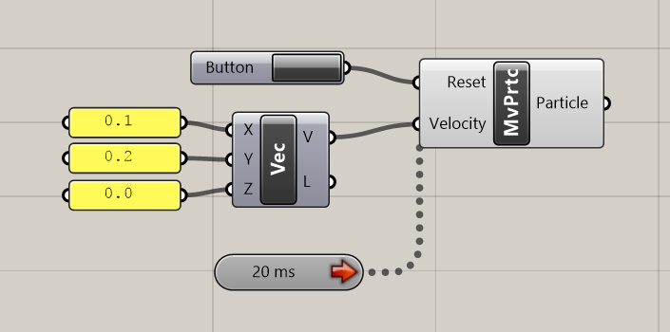

Slide 35
OOP
Objected-Oriented Programming

Slide 36
Class = user-defined data type

Slide 37
Defining a class
CONVENTION:
Names of public members start with uppercase
class Pyramid
{
public Plane BasePlane;
public double Length;
public double Width;
public double Height;
}
Using the class (client code)
Pyramid myPyramid = new Pyramid();
myPyramid.BasePlane = Plane.WorldXY
myPyramid.Length = 1.2;
myPyramid.Width = 3.4;
myPyramid.Height = 5.6;

Slide 38
C# Script Component
class ScriptInstance : GH_SriptInstance
{
private void RunScript()
{
Pyramid myPyramid = new Pyramid();
myPyramid.BasePlane = Plane.WorldXY;
myPyramid.Length = 1.2;
myPyramid.Width = 3.4;
myPyramid.Height = 5.6;
}
class Pyramid
{
public Plane BasePlane;
public double Length;
public double Width;
public double Height;
}
}

Slide 39
Class definition
class Pyramid
{
public Plane BasePlane;
public double Length;
public double Width;
public double Height;
public Pyramid(Plane basePlane, double length, double width, double height)
{
BasePlane = basePlane;
Length = length;
Width = width;
Height = height;
}
}
Constructor
Similar to the _init function in Python

Slide 40
Client code
Pyramid myPyramid = new Pyramid(Plane.WorldYZ, 1.2, 3.4, 5.6);
Plane yourBasePlane = new Plane(new Point3d(1.0, 1.0, 2.0), Vector3d.ZAxis);
Pyramid yourPyramid = new Pyramid(yourBasePlane, 3.0, 3.0, 2.0);
Class definition
class Pyramid
{
...
public Pyramid(Plane basePlane, double length, double width, double height)
{
BasePlane = basePlane;
Length = length;
Width = width;
Height = height;
}
}
CONVENTION:
Names of public members start with uppercase

Slide 41
Class definition
class Pyramid
{
public Plane BasePlane;
public double Length;
public double Width;
public double Height;
...
public Pyramid(double length, double width, double height)
{
BasePlane = Plane.WorldXY;
Length = length;
Width = width;
Height = height;
}
}
Another constructor

Slide 42
Client code
Pyramid myPyramid = new Pyramid(Plane.WorldYZ, 1.2, 3.4, 5.6);
Pyramid yourPyramid = new Pyramid(3.0, 3.0, 2.0);

Slide 43
Class definition
class Pyramid
{
public Plane BasePlane;
public double Length;
public double Width;
public double Height;
...
public Pyramid()
{
BasePlane = Plane.WorldXY;
Length = 1.0;
Width = 1.0;
Height = 1.0;
}
}
Default constructor

Slide 44
Class definition
class Pyramid
{
public Plane BasePlane = Plane.WorldXY;
public double Length = 1.0;
public double Width = 1.0;
public double Height = 1.0;
...
}

Slide 45
Class definition
class Pyramid
{
public Plane BasePlane;
public double Length;
public double Width;
public double Height;
...
public Pyramid()
{
BasePlane = Plane.WorldXY;
Length = 1.0;
Width = 1.0;
Height = 1.0;
}
}

Slide 46
Client code
Pyramid myPyramid = new Pyramid(myPlane, 1.2, 3.4, 5.6);
Pyramid yourPyramid = new Pyramid(3.0, 3.0, 2.0);
Pyramid herPyramid = new Pyramid();

Slide 47
Class definition
class Pyramid
{
public Plane BasePlane;
public double Length;
public double Width;
public double Height;
…
public double ComputeVolume()
{
return 0.3333 * Length * Width * Height;
}
}
CONVENTION:
Names of public members start with uppercase
Client code
Pyramid myPyramid = new Pyramid(myPlane 1.0, 1.0, 3.0)
double myPyramidVolume = myPyramid.ComputeVolume();
Pyramid yourPyramid = new Pyramid(2.0, 2.0, 3.0);
double yourPyramidVolume = yourPyramid.ComputeVolume();

Slide 48
Compute the display lines of the pyramid
Class Pyramid
{
...
public List<LineCurve> ComputeDisplayLines()
{
Point3d A = BasePlane.Origin + BasePlane.XAxis * Length * 0.5 + BasePlane.YAxis * Width * 0.5;
Point3d B = BasePlane.Origin - BasePlane.XAxis * Length * 0.5 + BasePlane.YAxis * Width * 0.5;
Point3d C = BasePlane.Origin - BasePlane.XAxis * Length * 0.5 - BasePlane.YAxis * Width * 0.5;
Point3d D = BasePlane.Origin + BasePlane.XAxis * Length * 0.5 - BasePlane.YAxis * Width * 0.5;
Point3d M = BasePlane.Origin + BasePlane.ZAxis * Height;
List<LineCurve> displayLines = new List<LineCurve>();
displayLines.Add(new LineCurve(A, B));
displayLines.Add(new LineCurve(B, C));
displayLines.Add(new LineCurve(C, D));
displayLines.Add(new LineCurve(D, A));
displayLines.Add(new LineCurve(A, M));
displayLines.Add(new LineCurve(B, M));
displayLines.Add(new LineCurve(C, M));
displayLines.Add(new LineCurve(D, M));
return displayLines;
}
...
}
M
Z
C
B
Y
D
X
basePlane
A

Slide 49
“Public” and “Private”
Class definition
Client Code
class Pyramid
{
public double Length;
public double Width;
public double Height;
public Plane BasePlane;
private double topAngle;
}
Pyramid myPyramid = new Pyramid();
myPyramid.Length = 2.0;
myPyramid.topAngle = 15.0;
Private variables and functions cannot be accessed from outside the class definition
They are to be used internally within a class definition

Slide 50
Namespace

Slide 51

Namespace: Classes with identical names can coexist
RhinoComomon.dll
RevitAPI.dll
namespace Rhino.Geometry
{
public class Curve
{
...
}
}
namespace Autodesk.Revit
{
public class Curve
{
...
}
}
Rhino.Geometry
Autodesk.Revit

Slide 52
Namespace
RhinoComomon.dll
RevitAPI.dll
namespace Rhino.Geometry
{
public class Curve
{
...
}
}
namespace Autodesk.Revit
{
public class Curve
{
...
}
}
Your GH plugin
namespace Workshop
{
Rhino.Geometry.Curve myRhinoCurve = new Rhino.Geometry.Curve();
Autodesk.Revit.Curve myRevitCurve = new Autodesk.Revit.Curve();
}

Slide 53
Namespace
RhinoComomon.dll
RevitAPI.dll
namespace Rhino.Geometry
{
public class Curve
{
...
}
}
namespace Autodesk.Revit
{
public class Curve
{
...
}
}
Your GH plugin
using Rhino.Geometry;
namespace Workshop
{
Curve myRhinoCurve = new Curve();
Autodesk.Revit.Curve myRevitCurve = new Autodesk.Revit.Curve();
}

Slide 54
Namespace
RhinoComomon.dll
RevitAPI.dll
namespace Rhino.Geometry
{
public class Curve
{
...
}
}
namespace Autodesk.Revit
{
public class Curve
{
...
}
}
Your GH plugin
using Rhino.Geometry;
using Autodesk.Revit;
namespace Workshop
{
Curve myRhinoCurve = new Curve();
Curve myRevitCurve = new Curve();
}
Error: Ambiguous !!!

Slide 55
Namespace
RhinoComomon.dll
RevitAPI.dll
namespace Rhino.Geometry
{
public class Curve
{
...
}
}
namespace Autodesk.Revit
{
public class Curve
{
...
}
}
Your GH plugin
using RhinoCurve = Rhino.Geometry.Curve
using RevitCurve = Autodesk.Revit.Curve
namespace Workshop
{
RhinoCurve myRhinoCurve = new RhinoCurve();
RevitCurve myRhinoCurve = new RevitCurve();
}

Slide 56



Namespace can be nested (just like folders)
namespace Rhino
{
namespace Geometry
{
public class Curve
{
...
}
}
}
namespace Rhino.Geometry
{
public class Curve
{
...
}
}
=
Geometry
Rhino.Geometry
Rhino

Slide 57
A namespace can contains many (sub)namespaces
RhinoComomon.dll
namespace Rhino.Geometry
namespace Rhino.Display
namespace Rhino.Input

Slide 58
Live Example: namespaces and classes
Implementing the Pyramid class in Visual Studio

Slide 59
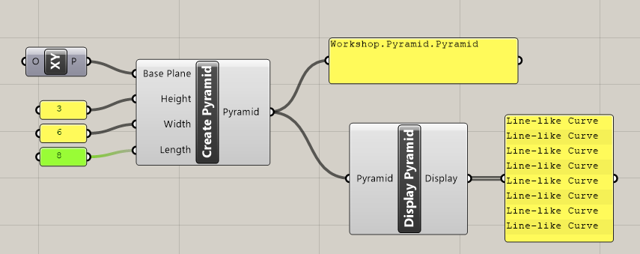
Now, we need to define some custom GH components,
so that the Pyramid class can be used in Grasshopper

Slide 60
The “Create Pyramid” component
namespace Workshop.Pyramid
{
public class GhcCreatePyramid : GH_Component
{
public GhcCreatePyramid()
: base("Create Pyramid", "Create Pyramid",
"Create Pyramid from position, length, width and height",
"Workshop", "Pyramid")
{
}
protected override void RegisterInputParams(GH_Component.GH_InputParamManager pManager) { ... }
protected override void RegisterOutputParams(GH_Component.GH_OutputParamManager pManager) { ... }
protected override void SolveInstance(IGH_DataAccess DA) { ... }
protected override System.Drawing.Bitmap Icon { ... }
public override Guid ComponentGuid { ... }
}
}

Slide 61
The “Create Pyramid” component
...
rotected override void RegisterInputParams(GH_Component.GH_InputParamManager pManager)
{
pManager.AddPlaneParameter("Base Plane", "Base Plane", "Base Plane", GH_ParamAccess.item,
Plane.WorldXY);
pManager.AddNumberParameter("Height", "Height", "Height", GH_ParamAccess.item, 1.0);
pManager.AddNumberParameter("Width", "Width", "Width", GH_ParamAccess.item, 1.0);
pManager.AddNumberParameter("Length", "Length", "Length", GH_ParamAccess.item, 1.0);
}
protected override void RegisterOutputParams(GH_Component.GH_OutputParamManager pManager)
{
pManager.AddGenericParameter("Pyramid", "Pyramid", "Pyramid", GH_ParamAccess.item);
}
...

Slide 62
The “Create Pyramid” component
...
protected override void SolveInstance(IGH_DataAccess DA)
{
Plane iBasePlane = Plane.Unset;
double iHeight = double.NaN;
double iLength = double.NaN;
double iWidth = double.NaN;
DA.GetData("Base Plane", ref iBasePlane);
DA.GetData("Height", ref iHeight);
DA.GetData("Width", ref iWidth);
DA.GetData("Length", ref iLength);
Pyramid pyramid = new Pyramid(iBasePlane, iLength, iWidth, iLength);
DA.SetData("Pyramid", pyramid);
}
...

Slide 63
The “Display Pyramid” component
namespace Workshop.Pyramid
{
public class GhcDisplayPyramid : GH_Component
{
public GhcCreatePyramid()
: base(“Display Pyramid", " Display Pyramid ", "Display Pyramid ", "Workshop", "Pyramid")
{
}
rotected override void RegisterInputParams(GH_Component.GH_InputParamManager pManager)
{
pManager.AddGenericParameter("Pyramid", "Pyramid", " Pyramid", GH_ParamAccess.item);
}
protected override void RegisterOutputParams(GH_Component.GH_OutputParamManager pManager)
{
pManager.AddCurveParameter("Display", "Display", "Display", GH_ParamAccess.list);
}
...
}
}

Slide 64
The “Display Pyramid” component
namespace Workshop.Pyramid
{
public class GhcDisplayPyramid : GH_Component
{
...
protected override void SolveInstance(IGH_DataAccess DA)
{
Pyramid iPyramid = null;
DA.GetData("Pyramid", ref iPyramid);
DA.SetDataList("Display", iPyramid.ComputeDisplayLines());
}
...
}
}

Slide 65
Live Example
Adding icons to our components

Slide 66
Adding an icon to the class definition
namespace Workshop.Pyramid
{
public class GhcCreatePyramid : GH_Component
{
...
protected override void SolveInstance(IGH_DataAccess DA)
{ ... }
protected override System.Drawing.Bitmap Icon
{
get
{
return null;
return Workshop.Properties.Resources.Icon_PyramidCreate;
}
}
...
}
}

Slide 67

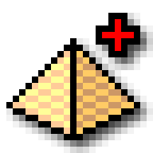
Grasshopper icon design tips
Resolution: 24 x 24
DPI: 96 pixel/inch (very important, otherwise icon will appear blurry!)
File formats: png, svg, … Avoid jpeg at all costs !
JPEG
PNG, SVG
Does not support transparency
Always contains artefacts
Supports transparency
Accurate pixel colors, no artefacts

Slide 68

Debugging with Visual Studio

Slide 69

Public and Private

Slide 70
“public” can cause funny problems
e.g. The user can set pyramid length to silly values
Pyramid myPyramid = new Pyramid();
myPyramid.Length = -1.2;
double myVolume = myPyramid.ComputeVolume(); // This will give negative volume !!!
class Pyramid
{
public Point3d Position;
public double Length;
public double Width;
public double Height;
...
}

Slide 71
“private” can prevent funny problems
e.g. by disallowing user to access pyramid length variable
Pyramid myPyramid = new Pyramid();
myPyramid.length = -1.2;
Error Message:
“length” is inaccessible due to its protection level
class Pyramid
{
private Point3d position;
private double length;
private double width;
private double height;
...
}

Slide 72
But …
now a “well-behaved” user can no longer query the length value of the pyramid ☹
Pyramid myPyramid = new Pyramid();
Print(myPyramid.length.ToString());
class Pyramid
{
private Point3d position;
private double length;
private double width;
private double height;
...
}

Slide 73
A possible solution: defining a “get” method
class Pyramid
{
private double length;
...
public double GetLength()
{
return length;
}
}
Now the user can query the length value (but cannot mess with it the length variable !!!)
Pyramid myPyramid = new Pyramid();
double myLength = myPyramid.GetLength();

Slide 74
Also: a “set” method
class Pyramid
{
private double length;
...
public double SetLength(double newLength)
{
if (newLength > 0.0)
length = newLength;
else
length = 0.1;
}
}
myPyramid.SetLength(-1.0);

Slide 75
So, each private variable comes with a “set” and “get” methods
class Pyramid
{
private double length;
...
public double GetLength()
{
return length;
}
public void SetLength(double inputLength)
{
if (inputLength > 0.0)
length = inputLength;
else
length = 0.0;
}
}

Slide 76
The get and set functions works well
But a bit inconvenient from the user’s perspective
Doing this…
myPyramid.SetLength(1988.10);
Print(myPyramid.GetLength());
… is not as nice as this …
myPyramid.Length = 1988.10
Print(myPyramid.Length)

Slide 77
Can we have the best of both worlds?
i.e. A safe and also convenient way to
get and set field values of objects
YES !
Introducing …

Slide 78
Properties
(of a class)

Slide 79
Previously, …
class Pyramid
{
private double length;
...
public double GetLength()
{
return length;
}
public void SetLength(double inputLength)
{
if (inputLength > 0.0)
length = inputLength;
else
length = 0.0;
}
}

Slide 80
Let’s define a “Property” instead,
Class definition
Client code
class Pyramid
{
private double length;
public double Length
{
get { return length; }
set
{
if (value > 0.0)
length = value;
else
length = 0.0;
}
}
}
Pyramid myPyramid = new Pyramid();
double myLength = myPyramid.Length;
myPyramid.Length = -2.0;
From the user’s perspective (the client code),
accessing the property Length feels like
accessing an ordinary field
And the designer of the class can still implement
“safeguarding” codes that handle silly input values

Slide 81
Use the “set” in the constructor
class Pyramid
{
private double length;
public double Length
{
...
}
public Pyramid(Point3d position, double length, double width, double height)
{
...
Length = length
...
}
}

Slide 82
Public class vs. internal class
Public classes can be used from outside of the library
public class MyGrasshopperComponent : GH_Component
{
...
}
Internal classes can only be used within the library
class Pyramid
{
...
}

Slide 83
The “parametric” engine
of Grasshopper

Slide 84
Forward-Propagating Parametric Model

Slide 85
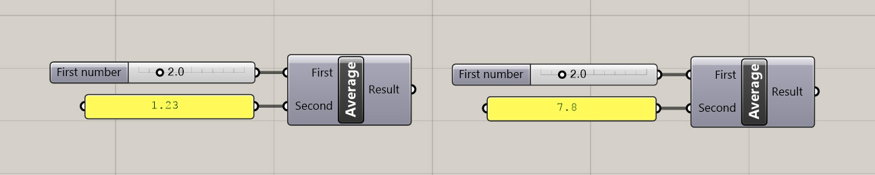
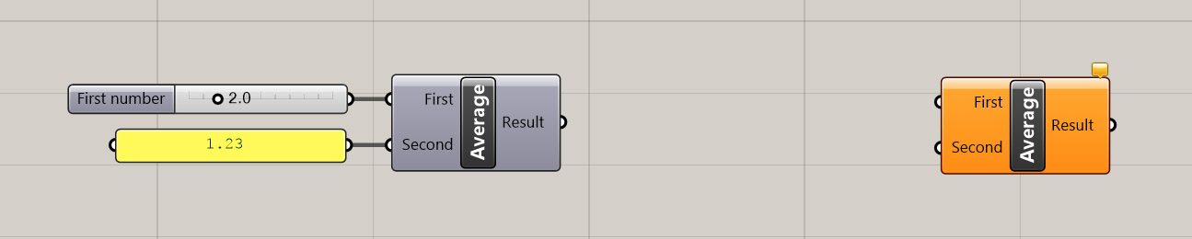
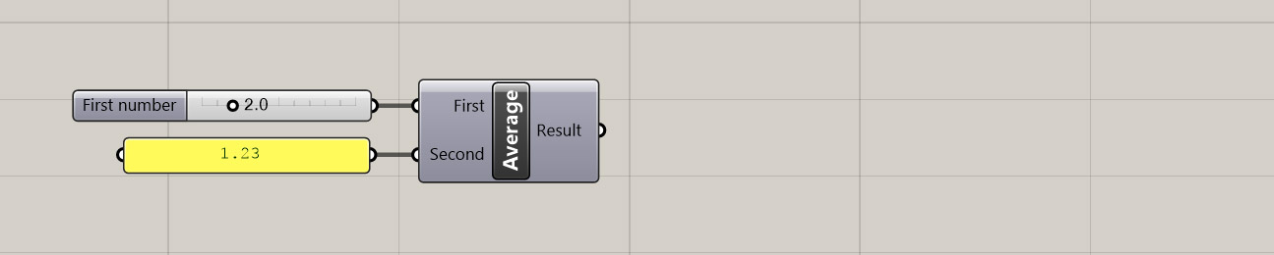

Behind-the-scene: How Grassshopper creates the custom component we defined
GhcAverage ghcAverage1 = new GhcAverage(...)
ghcAverage1.RegisterInputParams(pManager)
ghcAverage1.RegisterOutputParams(pManager)
...
ghcAverage1.SolveInstance(DA)
GhcAverage ghcAverage2 = new GhcAverage()
ghcAverage2.RegisterInputParams(pManager)
ghcAverage2.RegisterOutputParams(pManager)
...
ghcAverage2.SolveInstance(DA)

Slide 86
Inheritance

Slide 87
LandAnimal
class LandAnimal
{
public string Name;
public double Weight;
protected int legCount;
protected void eat() {...}
}
Inherit
Inherit
Dog
Human
class Dog : LandAnimal
{
public string breed;
public void bark() {...}
}
class Human : LandAnimal
{
public string Nationality;
public void ChangeNationality() {...}
}
All public and protected (but not private) members of LandAnimal will
automatically be added to Dog (and Human) class definition

Slide 88
Inheritance can be indirect and multi-level
LandAnimal
Human
class Human : LandAnimal
{
public string Nationality;
public void ChangeNationality() {...}
}
Architect
Engineer
class Architect : Human
{
public string ArchitectLicenseID;
public void Design() {...}
}
class Engineer : Human
{
public string EngineerLicenseID;
public void BuildRobot() {...}
}

Slide 89
Some terminologies
Dog inherits LandAnimal
Dog is derived from LandAnimal
LandAnimal is the parent class of Dog
base class
Dog is a child class of LandAnimal
derived class
LandAnimal
Dog

Slide 90
Example: Class inheritance in RhinoCommon

Slide 91
Degree, Dimension, Domain
ClosestPoint()
PointAt()
Curve
LineCurve
ArcCurve
NurbsCurve
PolyCurve
Line
Points
Reparametrize()

Slide 92
Object
GeometryBase
Curve
Brep
Mesh
Surface
LineCurve
ArcCurve
NurbsCurve
PolyCurve

Slide 93
Why is class inheritance useful?

Slide 94
Provide a template for class definition
Degree, Dimension, Domain
ClosestPoint()
PointAt()
Curve
LineCurve
ArcCurve
NurbsCurve
PolyCurve

Slide 95
Provide a template for class definition
The class definitions for our GH plugin components are based on the GH_Component class “template”
This is how Grasshopper can automatically “recognizes” our components when the .gha file is installed
class MyGrasshopperComponent : GH_Component
{
protected override void RegisterInputParams(GH_Component.GH_OutputParamManager pManager)
{ }
protected override void RegisterOutputParams(GH_Component.GH_OutputParamManager pManager)
{ }
protected override void SolveInstance(IGH_DataAccess DA)
{ }
}

Slide 96
Re-use codes from the base class
class MyFirstGrasshopperComponent : GH_Component
{
...
protected override void SolveInstance(IGH_DataAccess DA)
{
...
AddRuntimeMessage(GH_RuntimeMessageLevel.Error, “Check the inputs, you idiot!”);
...
}
...
}
This function was defined in the base class GH_Component and can be readily used by us

Slide 97
“Polymorphism”
Provides a common interface for related types
e.g. if a function asks for an input of type Curve,
we can also input any type derived from Curve
void MoveCurve(Curve curve)
{
...
}
ArcCurve
LineCurve
Curve
NurbsCurve
ArcCurve myArcCurve = new ArcCurve(...);
MoveCurve(myArcCurve);
LineCurve myLineCurve = new LineCurve(...);
MoveCurve(myLineCurve);
PolyCurve

Slide 98
Struct

Slide 99
struct is similar to class
For example:
Point3d (defined by RhinoCommon) is actually a struct, not a class
public struct Point3d
{
public double X;
public double Y;
public double Z;
public Point3d() { ... }
public Point3d(double X, double Y, double Z) { ... }
public DistanceTo(Point3d other) { ... }
...
}

Slide 100
Usually, struct are used to define simple data types
There is no inheritance

Slide 101
Important Difference
Struct is value type
Class is reference type
Point3d myPoint
X, Y, Z
Pyramid myPyramid
actual pyramid data
(base plane, length, width, height)

Slide 102
Enumeration Type

Slide 103
A data type that describes the day of the week
Defining an enumeration type
enum Days {Sat, Sun, Mon, Tue, Wed, Thu, Fri};
Using the enumeration types
Days myFavouriteDay = Days.Sunday;
Days yourFavouriteDay = Days.Friday;
BTW, enum types are value types

Slide 104
Example: an enum type from Grasshopper API
Previously
AddRuntimeMessage(GH_RuntimeMessageLevel.Error, “Check the inputs, you idiot!!!”);
An enumeration type
Defined by Grasshopper API
public enum GH_RuntimeMessageLevel { Blank, Remark, Warning, Error };

Slide 105
Static classes
Static class members

Slide 106
Static variables of a class
For example:
Point3d (defined by RhinoCommon) is actually a struct, not a class
public struct Point3d
{
public double X;
public double Y;
public double Z;
public Point3d() { ... }
public Point3d(double X, double Y, double Z) { ... }
public DistanceTo(Point3d other) { ... }
...
}

Slide 107
Static functions of a class
Called directly from the class, rather than from an instance of the class
Inside the Math class defined by .NET framework
public class Math
{
static public double Cos(double angle) { ... }
}
Client Code
double result = Math.Cos(3.14);
Instead of ...
Math myMathObject = new Math();
double result = myMathObject.Cos(3.14);

Slide 108
Static functions of a class
Called directly from the class, rather than from an instance of the class
NurbsCurve class definition (inside RhinoCommon)
public class NurbsCurve
{
public Point3d PointAt(double t) { ... }
static public NurbsCurve Create(bool periodic, int degree, IEnumerable<Point3d> points)
{ ... }
}
Client Code 1: The PointAt function must be called on an instance of NurbsCurve class
Point3d pointOnCurve = myCurve.PointAt(0.5);
Client Code 2: calling the Create function directly from the NurbsCurve class
NurbsCurve myCurve = NurbsCurve.Create(...);

Slide 109
Static variables of a class
Inside the Math class defined by .NET framework
public class Math
{
static public double PI = 3.1418...;
}
Client Code
double circleArea = Math.PI * radius * radius

Slide 110
Static class
cannot be instantiated
e.g. The Math class is actually defined as static
static public class Math
{
...
}

Slide 111
Live example:
Defining a static Util class

Slide 112
A static class that contains some handy utility routines
public static class Util
{
static Random random = new Random();
public static Point3d GetRandomPoint(double minX, double maxX, double minY, double maxY, double minZ, double maxZ)
{
double x = minX + (maxX - minX) * random.NextDouble();
double y = minY + (maxY - minY) * random.NextDouble();
double z = minZ + (maxZ - minZ) * random.NextDouble();
return new Point3d(x, y, z);
}
}

Slide 113
A static class that contains some handy utility routines
static class Util
{
...
public static Vector3d GetRandomUnitVectorXY()
{
double angle = 2.0 * Math.PI * random.NextDouble();
double x = Math.Cos(angle);
double y = Math.Sin(angle);
return new Vector3d(x, y, 0.0);
}
}

Slide 114
Mesh Growth
by subdivision and avoiding self-collision

Slide 115
Mesh in RhinoCommon

Slide 116
4
1
0
Faces[0] refers to v2, v4, v1
Faces[1] refers to v0, v3, v2, v1
Faces[2] refers to v2, v3, v5
2
0
1
2
3
5

Slide 117
Halfedge Mesh
An alternative way to represent a mesh

Slide 118
11
4
10
1
Let’s examine halfEdge2
halfEdge2.StartVertex: 2
halfEdge2.NextHalfEdge: 4
halfEdge2.PreviousHalfEdge: 0
halfEdge2.AdjacentFace: 1
0
9
8
5
3
4
2
2
0
1
0
6
12
7
1
13
2
3
14
5
15

Slide 119
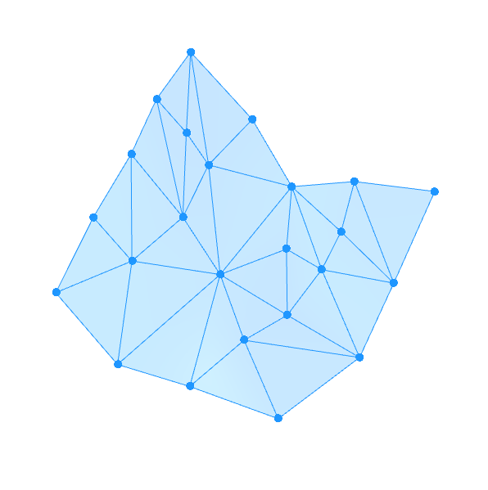
Two essential mechanisms:
Vertices push each other away (using sphere-sphere collision)
As an edge gets longer than a given threshold, it will be split into two shorter edges
Two extra mechanisms:
Edge Length constraint: Prevent an edge from getting too long
Bending resistance: Each pair of adjacent triangles will try to be flat

Slide 120
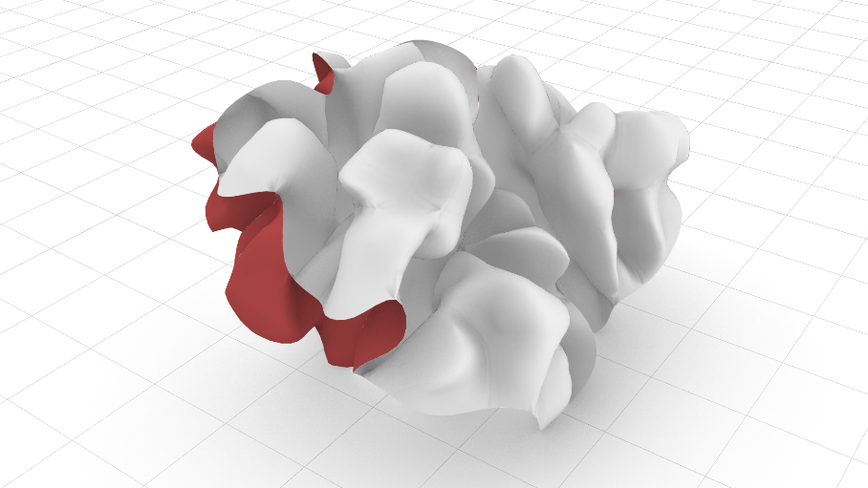
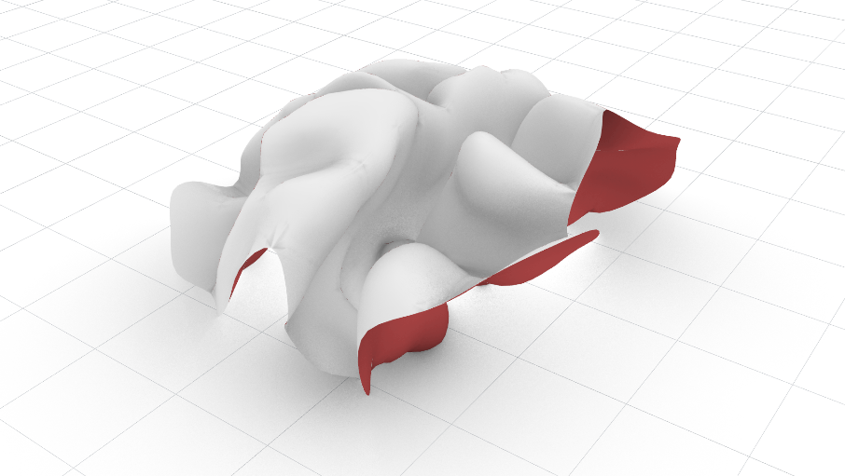
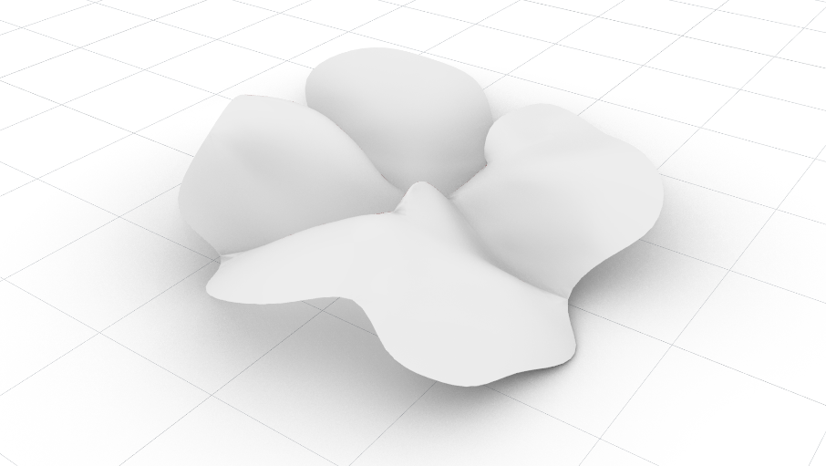
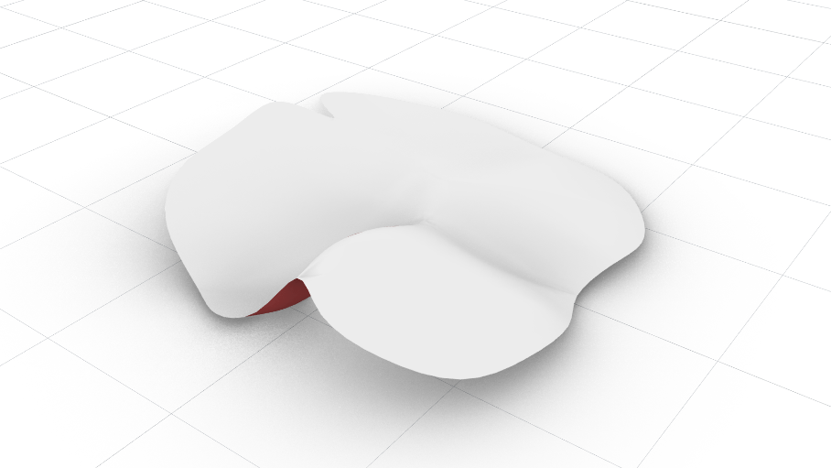
The Influence of Bending Resistance
No
bending resistance
Low
bending resistance
Moderate
bending resistance
High
bending resistance

Slide 121
How to correctly combine different move vectors
Blend the vectors with equal percentage:
b
Average = (a + b + c) * 0.33
Average = 0.33 * a + 0.33 * b + 0.33 * c
c
a
What if we want to make “a” more influential:
Average = 0.9 * a + 0.05 * b + 0.05 * c

Slide 122
Blending vectors according to certain blending ratio
If we want to blend a, b, c according to the ratio 2:1:1
2 * a + 1 * b + 1 * c
Average =
2 + 1 + 1
=
0.5 * a + 0.25 * b + 0.25

